Slide 1

Descriptive and Predictive analytics Professor Adrien Houdart Abdon Ahuile Stephanie Beyer Diaz Philipp Borchert Subhamoy Dam Edward Vrijghem

Slide 2
“If we have data, let’s look at data. If all we have are opinions, let’s go with mine.” — Jim Barksdale

Slide 3
Goal
Increase the total gifted amount through a client re-activation campaign

Slide 4
€ 38 180
626 re-activated clients
€ 25 002
FINDINGS
Total of expected gifts
Of the 6336 clients contacted
Campaign outcome
Notes:
This is all for the 10% response case
Outcome = (sum of gifts)-(number of clients contacted*0,5)
re-activated clients = right bottom column of confusion matrix
Total clients contacted = right bottom + right top of confusion matrix
0,5 is the cost per direct mail ( specified by the professor)

Slide 5
Confusion Matrix
 | Predicted <= 35 | Predicted > 35
Donate <= 35 | 19225 | 6267
Donate > 35 | 83 | 69
Target
Donors without campaign

Slide 6


Donor Profile
Speaks Dutch
40€
Maximum amount gifted
7.5
Times donated (average)
3.5 yrs
Last gift received
Notes:
Speaks Dutch
Has a maximum gift higher than €40
Donated on average 7.5 times
Donated his last gift on average 3.5 yrs. ago

Slide 7
Campaign analysis
€3 168
Overall cost
€45
Avg. donation
5% response
313 donators
€14 085 return
ROI €10 917
10% response
626 donators
€28 170 return
ROI €25 002
15% response
940 donators
€42 300 return
ROI €39 132
Notes:
3 scenarios: from most pessimistic to most optimistic. Response rate based on confusion matrix, which is where we get number of donators from.
Return corresponds to the response rates by avg donation, gotten from the model data. Overall cost corresponds to the 0.5 euros for contacting each of our targeted donors.

Slide 8
Methodology
Cleaning and preparing the data
Selecting optimal features
Choosing best prediction method
Random Forest
Developing a client profile
Notes:
More details in Jupyter Notebook.
Data preparation: filtering dates before 2013, correcting outliers, creating dummy variables
Feature selection: stepwise, looking at confusion matrix information (F1 score), avoiding correlated variables
Best prediction method: looking at variance to avoid overfitting
Client profile: based on model selected features

Slide 9
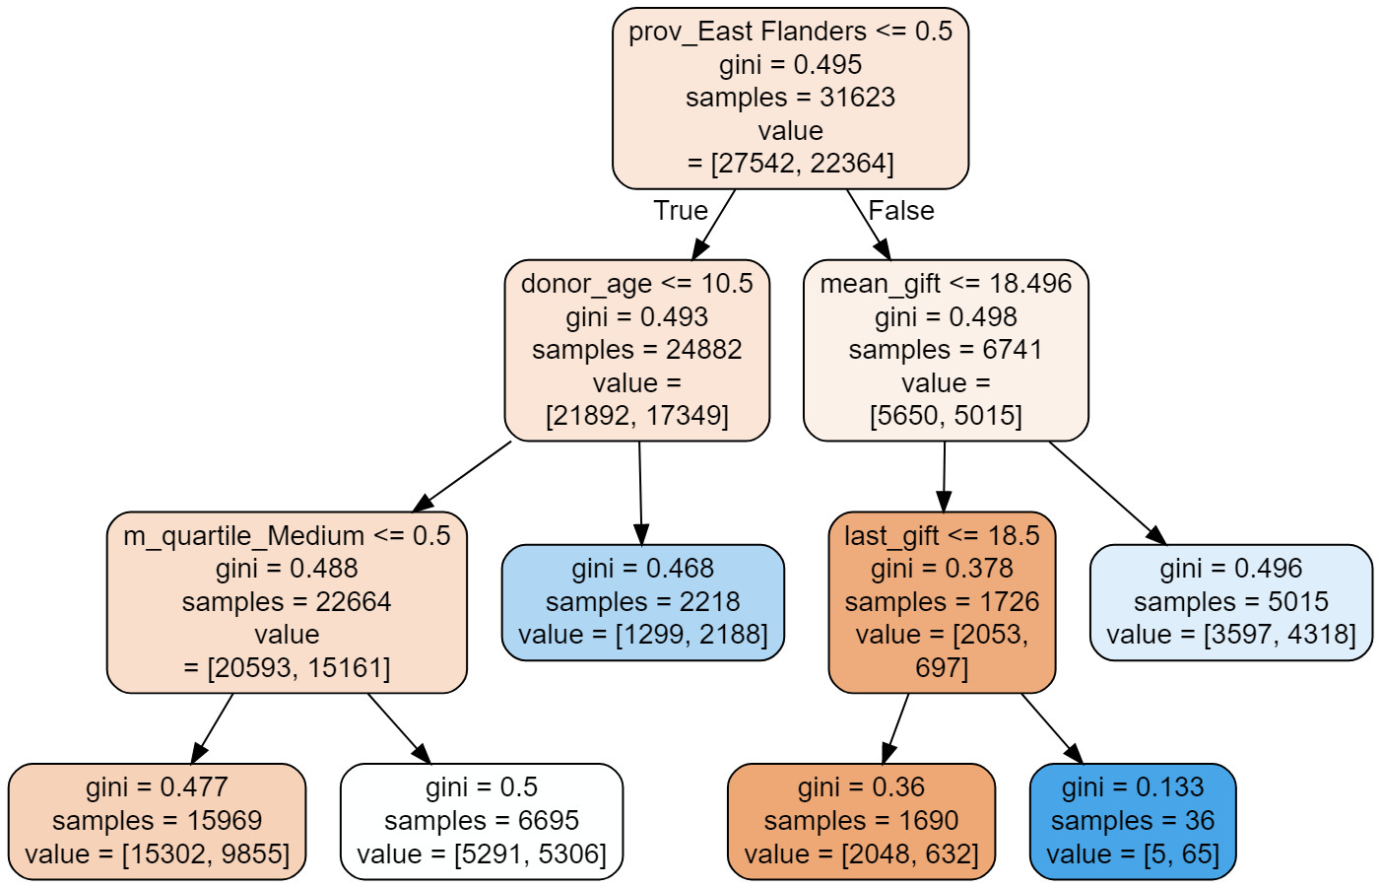
Notes:
The random forest model chooses the best features according to multiple trees.
Image show one decision tree out of random forest, as an example.
Left: true, right: false
Orange + white: 0s
Blue: 1s

Slide 10
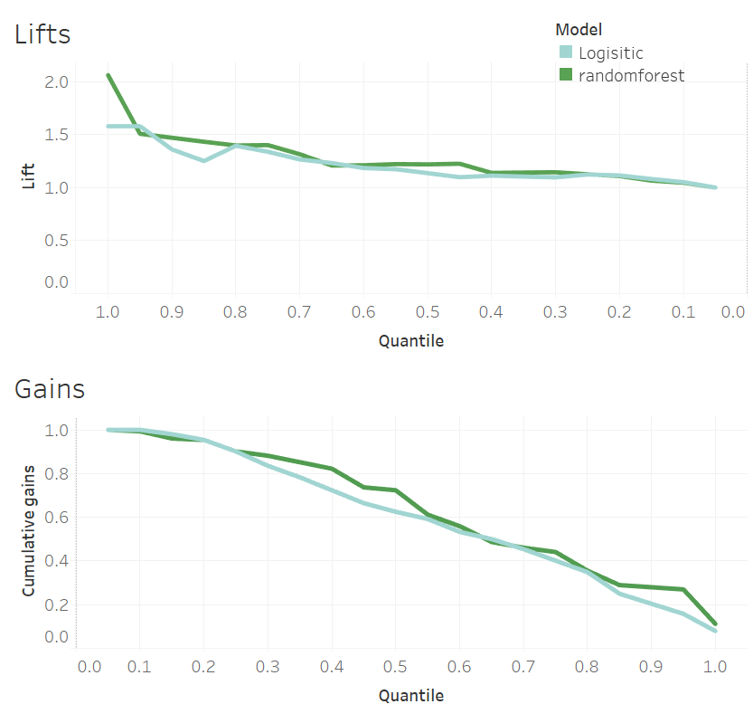

Slide 11
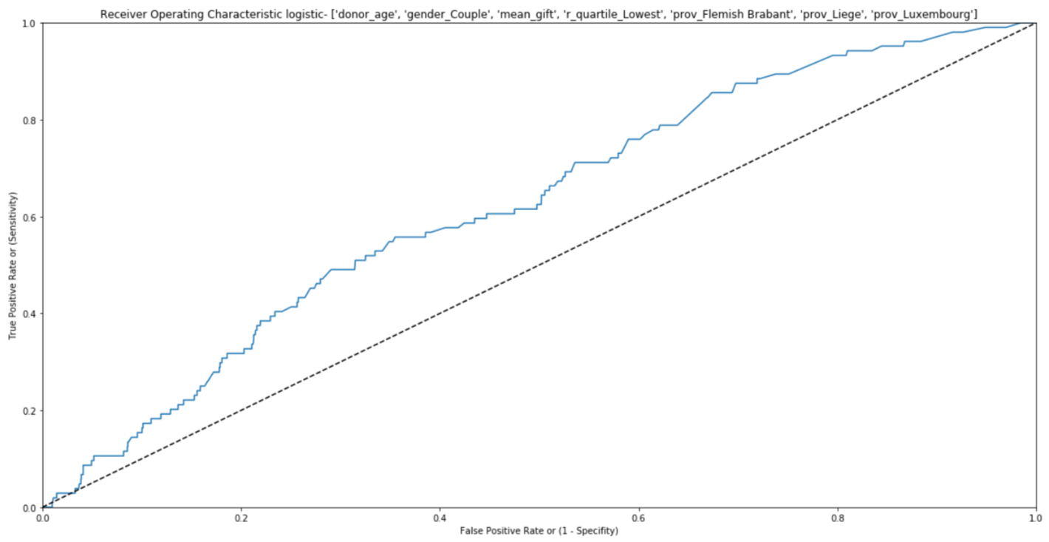
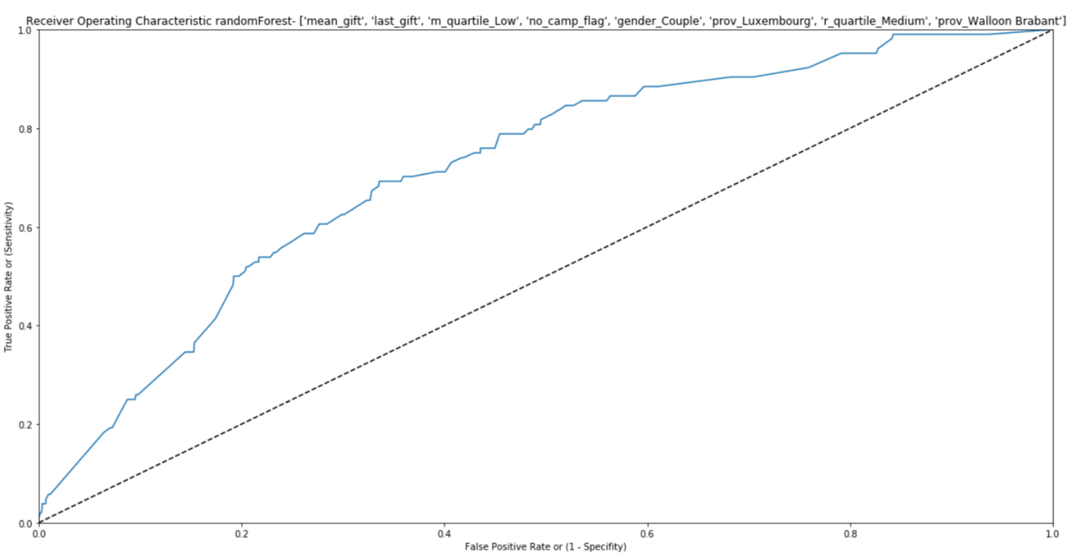
ROC curve and AUC
Logistic RoC and AUC
Random Forest RoC and AUC
Notes:
AUC: 0.69

Slide 12

Thanks!

